Slide 1

From Theory to Code Fixed-Point FIR Filter Design and Speech Quality Evaluation
Saikiran Chepa

Slide 2
Contents
1.
Finite Impulse Response (FIR) Filter Design
2.
Motivation for Fixed Point
3.
Floating-Point Representation (Refresher)
4.
Fixed-Point Representation
5.
Float-to-Fixed Conversion
6.
Fixed-Point Arithmetic Examples
7.
Practical Example
8.
Verification
9.
Summary
10.
Hands On

Slide 3

01
PART
Finite Impulse Response (FIR) Filter Design

Slide 4



Linear-phase design (symmetrical coefficients)
Always stable (no feedback terms)
Output depends only on current and past inputs
01.

Slide 5
General Equation: 𝑦 𝑛 = ∑ ℎ 𝑘 ∗ 𝑥 𝑛 − 𝑘
01
02
ℎ 𝑘 = filter coefficients
𝑥 𝑛 = input signal
03
04
𝑦 𝑛 = output signal
𝑁 = number of taps

Slide 6

How to do Convolution??
Direct Convolution
Multiply- accumulate (MAC) for each output sample ComplexityO(N·M) (N = input length, M = filter length) Simple but expensive for large filters
Overlap-Add (OLA)
Input split into blocks Each block convolved using FFT Results added with overlap Efficient for long filters
Overlap-Save (OLS)
Input divided into overlapping blocks FFT- based convolution, discarding invalid samples Memory- efficient alternative to OLA

Slide 7
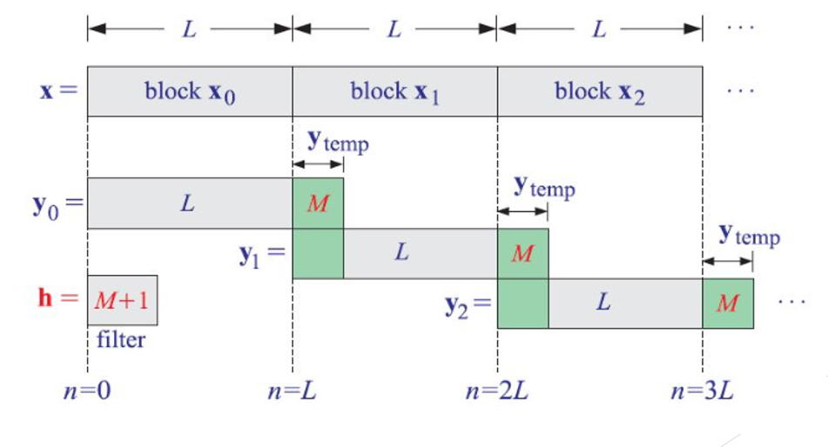

Slide 8
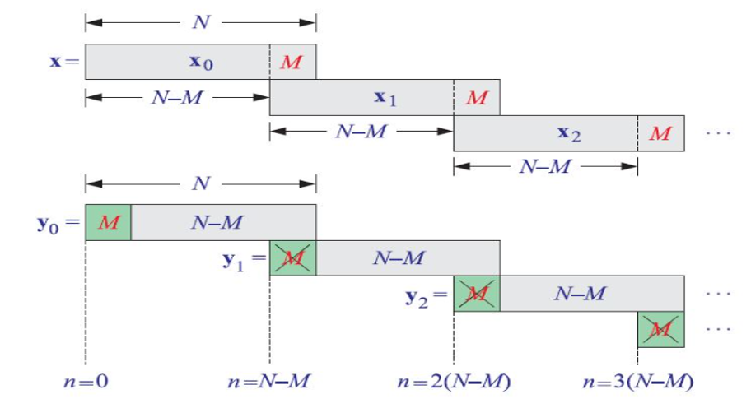

Slide 9
Design Steps
01
02
03
Specification
Select Parameters
Compute Coefficients
Define filter type (Low- pass, High- pass, Band- pass, Band- stop)
Pass band frequency Stop band frequency Pass band ripple Stop band attenuation
Using mathematical formulas (sinc + window) or tools (MATLAB/Python remez)
04
05
Implementation
Verification
Use convolution in C/Python (float or fixed- point)
Compare float vs fixed output (RMSE, PESQ for speech signals)

Slide 10
02
PART
Motivation for Fixed Point

Slide 11
Why fixed-point?
Lower power, smaller memory footprint
Faster execution on embedded DSP/MCU
Hardware limitations (many DSPs lack floating- point units)
Typical applicationsSpeech/audio codecs, filters

Slide 12
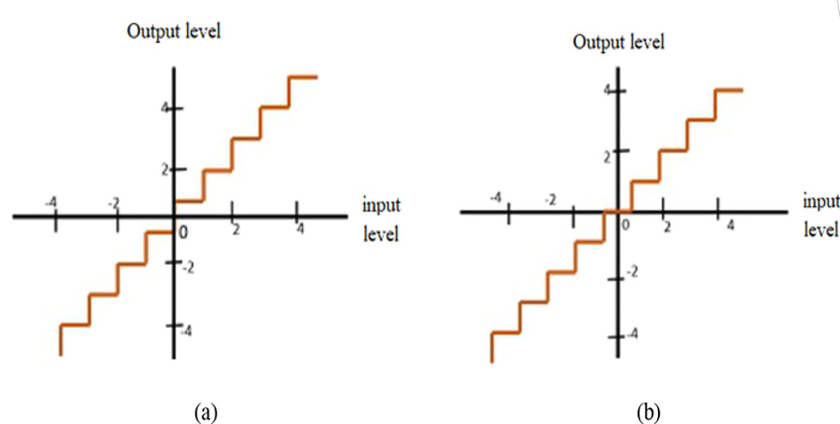
Quantizer Types: Mid-Rise and Mid-Tread

Slide 13
03
PART
Floating-Point Representation (Refresher)

Slide 14
IEEE 754 format (32-bit float)
01
Sign bit (1)
04
Advantages wide dynamic range, easy for algorithm development
02
Exponent (8)
05
Limitation not always efficient for embedded
03
Mantissa (23)

Slide 15
04
PART
Fixed-Point Representation

Slide 16
General format: Q1.m.n
sign bit
m = Range bits
n = fractional bits

Slide 17
Example: Q1.0.15 (16-bit signed fixed-point)
Q1.0.15 : Range –2⁰ to (2⁰ – 2⁻¹⁵) = - 1.0 to 1 - 2⁻¹⁵
Stored as 16- bit signed integer

Slide 18
05
PART
Float-to-Fixed Conversion

Slide 19

Formula: Q1.m.n Fixedpt_value = round (Floatingpt_value × 2ⁿ)
01
Example 1Float = 0.4768, Q1.0.15 → round(0.4768 × 2¹⁵) = 15628
02
Example 2Float = –0.5792, Q1.0.15 → round(–0.5792 × 2¹⁵) = –18979

Slide 20
Formula: Q1.m.n Fixedpt_value = round (Floatingpt_value × 2ⁿ)
01
Example 1Float = 2.4897, Q1.2.13 → round(0.4768 × 2¹³) = 20396
02
Example 2Float = –5.5872, Q1.3.12 → round(–0.5792 × 2¹²) = -22885

Slide 21
Precision vs. Range Trade-off
More fractional bits → higher precision, smaller range
More integer bits → larger range, lower precision
Balance depends on algorithm

Slide 22
06
PART
Fixed-Point Arithmetic Examples

Slide 23
Addition/Subtraction
01
Straightforward, same Q format

Slide 24
How to add Q1.2.13 and Q1.3.12??
Will you convert Q1.2.13 to Q1.3.12?? Or Will you convert Q1.3.12 to Q1.2.13??

Slide 25
Multiplication
Q1.m.n × Q1.m.n = Q2.2m.2n → need to re- scale

Slide 26

Division
Expensive, often replaced with reciprocal + multiply

Slide 27

Understanding Precision and Range in Fixed-Point Representation

Slide 28
Contents
1.
Fractional Bits and Precision
2.
Integer Bits and Range
3.
Balancing Precision and Range

Slide 29
PART.
01
Fractional Bits and Precision

Slide 30

Impact of More Fractional Bits
Higher Precision Explained
Increasing the number of fractional bits enhances the accuracy of numerical representation, allowing for more precise calculations, which is crucial in fields requiring detailed data.
Example: Q1.2.13 vs. Q1.2.29
The Q1.2.13 format provides limited precision compared to Q1.2.29, illustrating how the additional fractional bits in Q1.2.29 capture finer details in numerical values, affecting data integrity.

Slide 31
Trade-offs in Precision
01
02
Range Limitations
Real-world Applications
As more fractional bits are added, the range of representable values can decrease, leading to potential underflow or overflow issues that limit practical data use in various applications.
In engineering and computer graphics, the balance between precision and range is essential, influencing how data is processed and displayed in tools such as CAD software and gaming engines.

Slide 32
PART.
02
Integer Bits and Range

Slide 33
Importance of More Integer Bits
Larger Range Benefits
Examples in Data Representation
Increasing the number of integer bits allows for a greater range of values, enabling computers to accurately represent larger numbers without overflow, which is crucial for complex calculations.
In data representation, more integer bits can store larger integers, enhancing performance in applications like gaming and data analysis where numerical limits are often a concern.

Slide 34

Consequences of Increasing Integer Bits
Decreased Precision
While more bits increase the range, they can reduce precision in some contexts, affecting applications that rely on exact numeric representation, such as financial calculations.
.

Slide 35
PART.
03
Balancing Precision and Range

Slide 36
Understanding the Balance
Algorithmic Dependencies
01
Algorithmic dependencies refer to how various algorithms interact with data. Understanding these relationships helps in achieving optimal performance in precision and range while avoiding errors.
Practical Considerations
02
Practical considerations involve real- world factors such as computational resources, data variability, and context of use, influencing how to balance precision and range effectively in algorithm design.

Slide 37
07
PART
Practical Example

Slide 38

Total FIR Filter Coefficients is 13
01
02
03
Coefficients max: 2.786655772180386
Coefficients min: -2.9153372837924336
All Coefficients absolute sum: 23.597984136187275

Slide 39
How will you decide Q format for Coefficients??

Slide 40
08
PART
Verification

Slide 41

Compare float vs fixed-point FIR outputs
Metrics RMSE, PESQ score for speech signals
PESQ score → indicates perceptual quality difference

Slide 42
09
PART
Summary

Slide 43
10
PART
Hands On

Slide 44
Thanks
Edited by sai.406@gmail.com
PowerPoint Design

